Slide 1

TABLEAU PROJECT
India Crime Intelligence Dashboard
An interactive Tableau dashboard analysing national crime trends, state-wise hotspots, and cyber fraud patterns across India, 2015–2024.
62.4L
28+
10 Yrs
3
Total Crime Cases
States & UTs Covered
Data Span (2015–2024)
Linked Data Sources
Presented by: Mr. Sumit Suryavanshi
1
Notes:
Good afternoon everyone. I'm Sumit Suryavanshi, and today I'll be walking you through my Tableau project — the India Crime Intelligence Dashboard. This dashboard pulls together ten years of national crime data, from 2015 to 2024, across more than 28 states and union territories, and brings it together from three separate data sources into one interactive view. Over the next few minutes, I'll show you what the dashboard answers, how I built and debugged it, and the actual insights it surfaces. Let's start with why I built it.
1

Slide 2
PROJECT OBJECTIVE
What This Dashboard Sets Out to Answer
🗺️
State-wise Hotspots
💻
Cyber Crime Deep-Dive
📈
Trend & Anomalies
Identify which states report the highest crime volumes and how they rank against each other.
Break digital fraud into legal categories and track its growing share of total crime.
Track total crime from 2015–2024, flagging anomalies like the COVID lockdown spike.
⚖️
Legal Category Clarity
💸
Financial Impact
🎛️
Interactive Filtering
Distinguish overlapping-sounding crime heads — cheating, fraud, impersonation — by actual legal section.
Layer in average loss per complaint to connect case volume with real monetary harm.
Let viewers drill by Year, State and Top-N ranking without leaving the dashboard.
India Crime Intelligence Dashboard
2
Notes:
Before I show you any charts, let me frame the problem. This dashboard was built to answer six specific questions: which states carry the heaviest crime burden, how cyber crime is evolving separately from physical crime, whether there's any seasonality or anomaly in the ten-year trend, how to avoid confusing similarly-worded legal categories, what the financial impact of cyber fraud actually looks like, and finally, making sure none of this requires static screenshots — everything needed to be filterable by year, state, and a top-N ranking. That last point is important, because it's the difference between a report and a dashboard.
2

Slide 3
DATASET USED
Data Sources & Structure
🗂️
National Crime Summary by State & Year
3
1_crime_state_year_summary.csv
Linked Data Sources
state_ut, year, domain, crime_head, crime_category, cases — the core national + state-level crime table.
10 Yrs
🗂️
National Cyber-Scam Complaints (I4C)
Covered (2015–2024)
6_scam_national_complaints_I4C.csv
period, scope, complaints, amount_lost_rs_crore, avg_loss_per_complaint_rs — national cyber-scam financial data.
28+
States & UTs
🗂️
2024 Fraud Subtype Breakdown
7_fraud_subtypes_2024.csv
DATA SOURCE
fraud_category_2024, cases — a single-year (2024 only) fraud subtype breakdown, no historical range.
Compiled crime-data CSVs — original publisher not cited in the source files.
India Crime Intelligence Dashboard
3
Notes:
The dashboard is built on three separate CSV sources, joined through Tableau's federated data layer rather than one giant flat file. The main table is the state-year crime summary, which spans the full ten years and includes every state and crime domain. The second source is a national cyber-scam complaints table with financial figures — that's where the average loss per complaint comes from. The third source is fraud subtypes, but it's worth flagging honestly: that one only has 2024 data, no history, so I treat it differently in the dashboard and don't force a year filter onto it.
3

Slide 4
BUILD & DEBUGGING PROCESS
From Static Mock-up to Interactive Dashboard
01
Fixed the Layout
02
Wired the Year Parameter
03
Connected Filters Dashboard-Wide
Switched sizing from Automatic to Fixed (1366×768) and converted floating zones to a tiled grid for consistent rendering.
Built a YearMatch calculated field ([year] = [Select Year]) and applied it to every chart still hardcoded to one fixed year.
Applied State UT and Select Year as true cross-filters via Apply to Worksheets → All Using This Data Source.
04
Clarified Legal Categories
05
Standardised Color
06
Built Custom Chart Types
Relabeled confusingly similar crime heads (Sec.66D vs Section 318) with their actual legal section for clarity.
Assigned one categorical palette so each crime/domain field holds the same color across every chart in the dashboard.
Added a Lollipop chart for average loss per complaint and a Waterfall chart for year-over-year change.
India Crime Intelligence Dashboard
4
Notes:
This dashboard didn't start out interactive — it started as a static Tableau export that only worked on one screen size, with half its filters hardcoded. I want to walk through the real debugging process, not just the finished result, because this is the part that actually demonstrates Tableau skill. First, I fixed the canvas sizing and converted floating zones to a tiled layout, which solved the overlap and clipping issues. Then I found that three of my six charts — the composition chart, the donut, and the pareto chart — were silently ignoring my Select Year parameter because they had old fixed-year filters sitting underneath. I built one reusable calculated field, YearMatch, and wired it into each. I also went through and fixed inconsistent coloring, relabeled confusing legal categories, and added two chart types you don't usually see in a student project: a lollipop chart and a waterfall chart.
4

Slide 5
CALCULATED FIELDS & PARAMETERS
Key Logic Built in Tableau
YearMatch
Select Year / Top N
[year] = [Select Year]
Parameters driving the year filter
and the Top-N state ranking
dashboard-wide.
🛠️
Why Only Two
Every other chart in this dashboard runs on native Tableau aggregations (SUM, COUNT) with no custom logic needed. YearMatch is the one field that had to be hand-built and reused — it's what fixed three charts that were silently ignoring the Select Year parameter. Select Year and Top N are the two parameters that make the whole dashboard interactive rather than a fixed snapshot.
India Crime Intelligence Dashboard
5
Notes:
Here are the two pieces of logic doing the real work behind the dashboard. YearMatch is the calculated field I reuse across every chart that needed to respond to the Select Year parameter — it's what fixed the three charts that were silently ignoring the year filter. And the two parameters, Select Year and Top N, are what let a viewer actually control the dashboard instead of just looking at a fixed snapshot.
5

Slide 6
KEY INSIGHTS
Crime Overview & State Hotspots
62.4L
+7.2%
86,420
27,721
Total Crime (6,241,569)
YoY Growth
Cyber Crime Cases
Murder Cases
🔺
🥠
Uttar Pradesh Leads by a Wide Margin
A Clear COVID Anomaly
793,020 cases — nearly 33% more than #2 Maharashtra (596,103).
2020 recorded a one-time spike to 14.2M cases tied to lockdown-era reporting.
🏙️
👩
Top 5 States Dominate Volume
Crime Against Women is the Largest Domain
UP, Maharashtra, Kerala, Gujarat and Tamil Nadu together carry the bulk of national cases.
448,211 cases — the single biggest category after general cheating offences.
Figures reflect the 2015–2024 dataset filtered to the dashboard's default year.
India Crime Intelligence Dashboard
6
Notes:
Starting with the headline numbers: total crime sits at just over 6.2 million cases, up 7.2% year over year, with cyber crime at 86,420 and murder cases at 27,721. The state breakdown is where it gets interesting — Uttar Pradesh alone reports nearly a third more cases than the next closest state, Maharashtra. I also want to call out an anomaly rather than hide it: 2020 shows a sharp spike to over 14 million cases, which lines up with COVID lockdown-era reporting changes, not necessarily a genuine crime surge — that's the kind of context a dashboard needs, not just raw numbers. And across domains, crime against women is the largest single category after general cheating offences, at 448,000-plus cases.
6

Slide 7
KEY INSIGHTS
Cyber Crime Growth & Legal Categories
101,928
+129%
108K
8
Cyber Cases in 2024
Growth Since 2019
Fraud-type Complaints
Tracked Categories
Cyber Crime Concentration by Category
📈
Fraud
108K
Cyber Crime Rises Every Year
Online Fraud
97K
Steady growth 2019–2024, with the sharpest jump between 2022 and 2023.
Hacking
67K
Card / OTP Fraud
51K
🎯
Harassment
50K
80% from Just 2 Categories
Gambling
2K
Fraud and Online Fraud alone account for over 80% of complaints — a classic Pareto pattern.
Fake News
1K
UPI Fraud
1K
India Crime Intelligence Dashboard
7
Notes:
Cyber crime is the fastest-moving part of this dataset. It's grown from about 44,500 cases in 2019 to nearly 102,000 in 2024 — that's a 129% increase, and most of that growth happened after 2021. The category breakdown follows a textbook Pareto pattern: Fraud and Online Fraud alone account for over 80% of all cyber complaints, while categories like gambling, fake news and UPI fraud barely register in comparison. That matters operationally — if you're allocating cybercrime-cell resources, you'd focus overwhelmingly on those top two categories first.
7

Slide 8
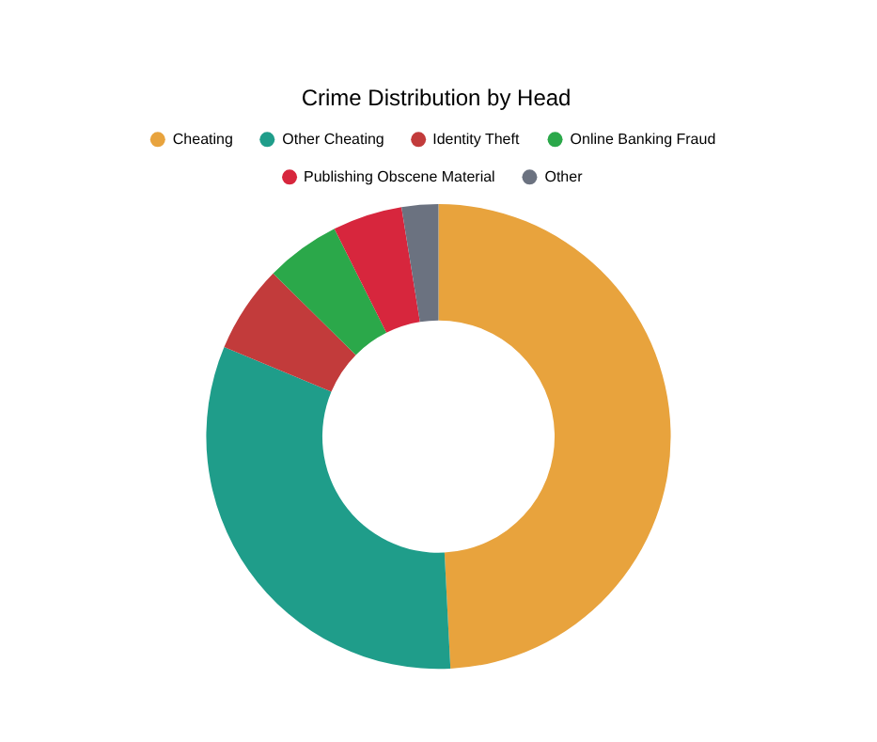
KEY INSIGHTS
Crime Composition & Distribution
🥧
Cheating Offences Dominate
Cheating + Other Cheating together make up over 80% of all cyber crime heads combined.
🏦
High-Impact Minority Categories
Online Banking Fraud and Identity Theft together account for ~11% — smaller but high-impact.
📊
Consistent Across States
Crime Against Women dominates the domain breakdown in 8 of the top 10 states.
India Crime Intelligence Dashboard
8
Notes:
Looking at composition rather than raw counts: cheating-related offences, split across two legal sections, make up more than 80% of the cyber crime head breakdown on their own. Online banking fraud and identity theft are smaller slices — together around 11% — but they carry a much higher financial impact per case, which is why I pulled in the separate average-loss dataset earlier. And this composition pattern isn't a one-off — crime against women dominates the domain breakdown in eight of the top ten states, so it's a structural pattern, not a fluke in one state's data.
8

Slide 9
CONCLUSION
What the Data — and the Build — Tell Us
📈
💻
⚖️
Crime Volume is Rising
Cyber Crime is the Fastest-Growing Threat
Legal Categories Needed Clearer Labels
Total crime up 7.2% YoY to 6.24M cases, with Uttar Pradesh alone contributing nearly 13% of the national total.
Cases more than doubled from 44,546 (2019) to 101,928 (2024), accelerating sharply after 2021.
Overlapping-sounding labels (Sec.66D vs Section 318) caused real confusion during analysis.
→ Prioritise UP, Maharashtra and Kerala — they consistently lead in volume.
→ Fraud and Online Fraud drive over 80% of complaints — resourcing should follow that concentration.
→ Relabeling by legal section, not plain English alone, prevents misreading the data.
🎛️
🚧
The Dashboard is Fully Interactive
Known Data Gaps, Documented Honestly
Year and State filters apply dashboard-wide; a Lollipop and Waterfall chart add depth beyond defaults.
The Filled Map shows blanks for some years because ipc_sll_total isn't populated in every year of the source file.
→ Built for exploration, not a static report — viewers can click through the story themselves.
→ Flagged as a limitation, not hidden — an honest dashboard beats a falsely complete one.
India Crime Intelligence Dashboard
9
Notes:
To bring it together: crime volume is genuinely rising, up 7.2% year over year, and it's concentrated — Uttar Pradesh alone accounts for nearly 13% of the national total, so that's where attention and resourcing should start. Cyber crime is the fastest-growing threat in this dataset, more than doubling in five years, and again concentrated in just two categories. On the build side, I want to be upfront about two things: legal category labels in the raw data were genuinely confusing — two different sections both read as 'cheating' in plain English — and I had to relabel them to prevent misreading. And there's a real data gap in the map for certain years, which I've documented rather than hidden. I'd rather show you an honest dashboard with a known gap than a falsely complete one. Finally, this isn't a static report — every chart you've seen today is filterable by year and state, live, on the dashboard itself.
9

Slide 10
Thank You
Built with Tableau · Calculated Fields · Parameters
3
10
6
6.24M
Data Sources
Years Analysed
Calculated Fields
Cases Tracked
10
Notes:
That's the full walkthrough — three data sources, ten years of crime data, six working calculated fields, and 6.24 million cases tracked in one interactive dashboard. Thank you for your time. Happy to open it up and click through the live version if you'd like to see the filters in action, or take any questions.
10

